Slide 2
Ethics and Health Care
Health Information Science 140
University of Victoria

Slide 3
Learning Objectives
9.1 Define relevant ethical terms.
9.2 Discuss ethical theories that shape health care decisions.
9.3 Explain the ethical principles that are important to the health care provider.
9.4 Summarize the rights Canadians have with respect to health care.
9.5 Describe ethical behaviour expected of health care professionals.
9.6 Explain ethical considerations relating to end-of-life issues.
9.7 Discuss ethical considerations relating to the allocation of resources in health care.
9.8 Briefly discuss the moral and ethical issues related to abortion and genetic testing.

Slide 4
Historical roots of ethics in health care: Hippocrates
460-375 BCE: Greek physician, Hippocrates
Born into family of priests, inherited practice of medicine.
He was opposed to the existing supernatural measures: he did not share the belief that diseases were sent from God.
He was the first to describe epilepsy as a disease of the brain, not as a sacred disease sent from the Devine.
Also, was opposed to the inheritance of opportunity; established the school of COS, teaching the art of medicine to those considered outsiders.
To this day, Hippocrates is considered the ‘Father of Medicine’.

Slide 5
Historical roots of ethics in health care: Hippocrates
Hippocratic Corpus
Collection of 60 early Greek medical works associated with Hippocrates’ medical theories to what he devised as ethical means of medical practice.
Hippocrates began Western societies’ development of medicine through a delicate blending of the art of healing and scientific observations.
His works shared how to identify symptoms of disease and proper diagnostic practices, and also the personable form of art – the art of true living and the art of medicine combined.
Hippocrates’ contributions became the foundation upon which Western medical practice was built.

Slide 6
Historical roots of ethics in health care: Hippocrates
Hippocratic Oath
The Hippocratic Oath, one of the oldest binding documents in history, refers to the ethical code attributed to Hippocrates.
Revered for his standards in medical practice, the oath has been adopted as a guide to conduct by the medical profession throughout the ages.
The oath dictates obligations of the physician to students of medicine and the duties of students to teacher. In the oath, the physician pledges to prescribe only beneficial treatments, according to his abilities and judgment; to refrain from causing harm or hurt; and to live an exemplary personal and professional life.
Today, most graduating medical-school students swear to some form of the oath, usually a modernized version.

Slide 7
Historical roots of ethics in health care: Hippocrates
Hippocratic Oath
Samples from original oath:
“I swear by Apollo by… all the Gods and Goddesses, making them my witness, that I will carry out according to my ability and judgment this oath…”
“Into whatsoever house I enter to help the sick and I will abstain from all intentional wrong-doing and harm…”
AD 245 through 17th century, evolved into ‘DO NO HARM’ as the foundation of ethical practice.

Slide 8
Historical roots of ethics in health care: Hippocrates
Hippocratic Oath
Challenges & Adaptations
Although the oath has long been an accepted tradition, a growing number of physicians have come to feel that it is inadequate to address the realities of a medical world that has witnessed huge scientific, economic, political, and social changes (e.g., legalized abortion, physician-assisted death, various conditions unheard of in Hippocrates' time). Fewer than half of oaths taken today insist the taker be held accountable for keeping the pledge.
With all this in mind, some doctors see oath-taking as little more than a pro-forma ritual with little value beyond that of upholding tradition.
Other physicians are taking broader aim. Some note, for example, that the classical Oath makes no mention of such contemporary issues as the ethics of experimentation, team care, or a doctor's societal or legal responsibilities.

Slide 9
Historical roots of ethics in health care: Hippocrates
Hippocratic Oath: Challenges & Adaptations
Modernized versions of the oath have appeared, such as the 1964 version shown in the Thompson (2020) text (Box 9.1 on p. 255), more aligned with contemporary concepts, philosophies and practices.
Examples of passages from the modernized version by Louis Lasagna (1964):
I swear to fulfill to the best of my ability…
I will respect the hard-won scientific gains…
I will apply for the benefits of the sick…
I will remember there is an art to medicine.
I will not be ashamed to say I know not.
I will respect privacy of my patients.
I will remember to treat the human being.
I will prevent disease.

Slide 10

ETHICS
Ethics is the study of standards of right and wrong in human behaviour.
The term ethics also refers to a code of behaviour or conduct.
Rights and obligations
Values
Virtues vs. vices
Criteria to tell the difference

Slide 11
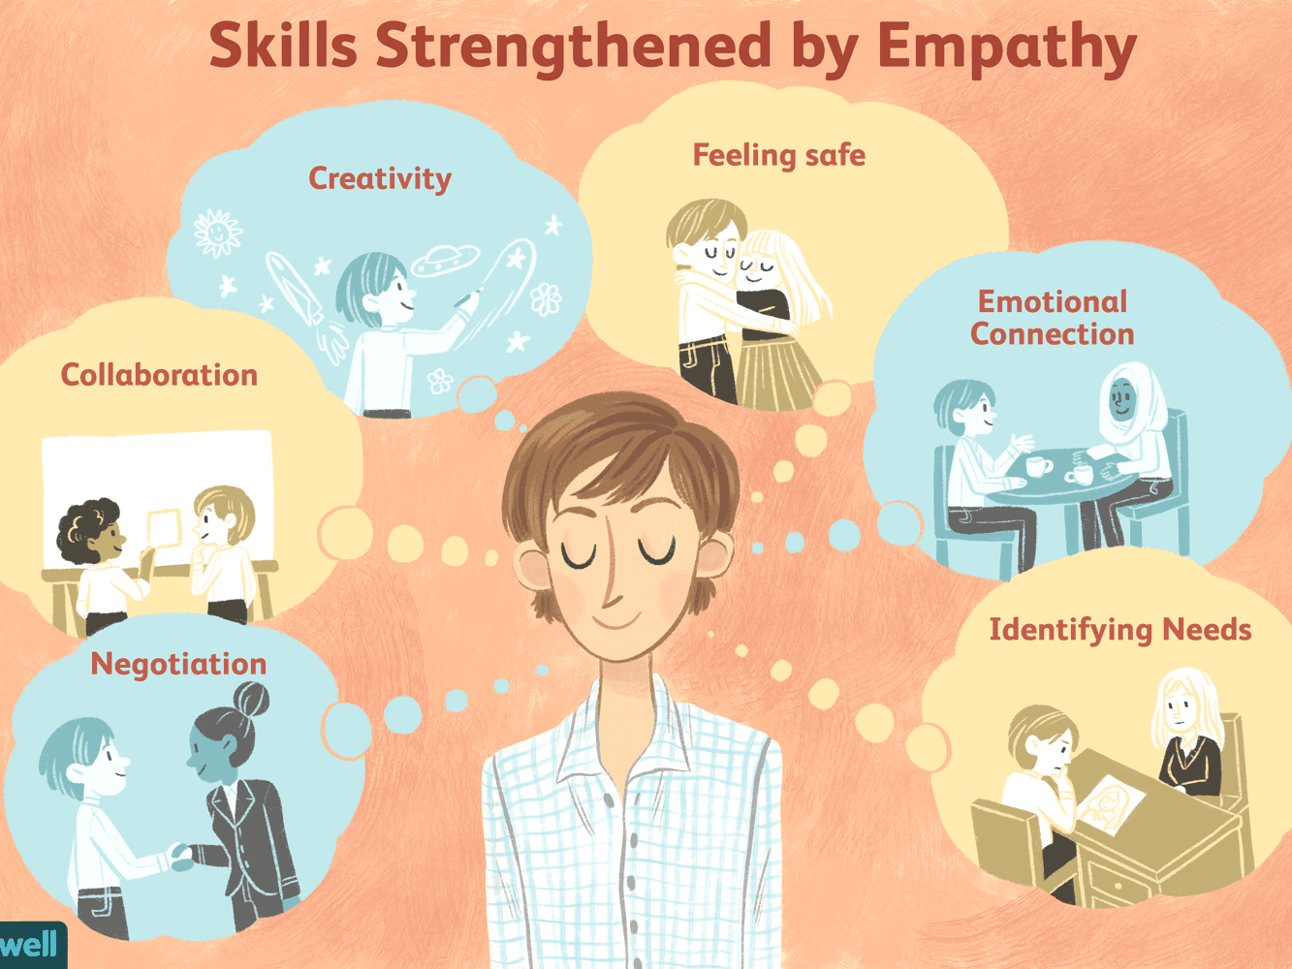
Key Terms and Concepts Empathy
One can understand another's perspective without it compromising your own beliefs or values
Empathy is the capacity to understand or feel what another person is experiencing from within their frame of reference, that is, the capacity to place oneself in another's position.

Slide 12

Morality and Morals
Morality extends from a system of beliefs about what is right and wrong, encompassing a person’s values, beliefs, and sense of duty and responsibility and can extend to those actions a person believes are right or wrong.
Morals are what a person believes to be right and wrong regarding how to treat others and how to behave in an organized society.

Slide 13

Values
Values, beliefs important to an individual, guide a person’s conduct and the decisions one makes.
People can have personal values, social values, and workplace or professional values.
Context may also influence values and, therefore, behaviour.
In health care, particular value is placed on truthfulness, respect for others, empathy, compassion, competency, responsibility and the right for autonomy and to proper medical care.

Slide 14

Sense of Duty
Duties are obligations a person has in response to another’s claims on the individual.
A duty may result from a professional or personal obligation or may relate to one’s own morals or values.
Health care providers have a moral and ethical duty to care for their patients in a competent manner, in addition to a legal obligation called the “duty of care.”
Reasonable standard of care based on profession’s standards of practice.

Slide 15
Ethical Theories: The Basics
Teleological theory defines an action as right or wrong depending on the results it produces.
Deontological theory demands that a moral and honest action is taken, regardless of the outcome.
Virtue ethics states that a person of moral character will act wisely, fairly, and honestly and will uphold the principles of justice.
Divine command ethics follows philosophies and rules set out by a higher power.

Slide 16
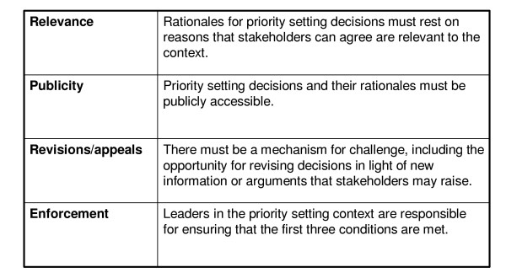
Accountability for reasonableness
Accountability for Reasonableness (AFR) is an ethics-based approach to a legitimate and fair priority-setting process that builds upon four conditions: relevance, publicity, appeals, and enforcement, which facilitate agreement on priority-setting decisions and gain support for their implementation.

Slide 17

Ethical Principles and the Health Care Professions
Ethical principles provide guidance for decision making and form the basis of ethical study.
Principles that are relevant to health care:
Beneficence
Nonmaleficence
Double effect
Respect
Autonomy
Truthfulness
Fidelity
Justice

Slide 18

Justice
Distributive
Compensatory
Procedural

Slide 19
Justice
Distributive justice: Concerned with the equitable and proper distribution of health care resources. Because it is prioritized and based on need, distribution may not be equal.
Compensatory justice: Has to do with the paying of compensation for wrongs done. For example, if it is proven that an individual’s medical condition resulted from improper safety practices (e.g., cancer from working with asbestos), the responsible company must compensate the person financially for pain and suffering and cover pertinent medical expenses. Similarly, there is obligation for financial compensation for a medical condition due to injury from a vehicle accident, from instances of proven medical malpractice resulting in injury, from physical or mental health condition related to being a first responder, etc.
Procedural justice: Acting in a fair and impartial manner. For example, seeing patients on a first come, first served basis; not giving preferential treatment to a friend, politician, prominent individual or celebrity in the community.

Slide 20
Patients’ Rights in Health Care
Rights in health care are things that can and should be expected of health care providers and the health care system.
Rights may be tangible or intangible.
All Canadians have explicit rights to health care itself and the right to timely health care.
Rights within health care include:
Patients’ right to one’s own medical records
The right to confidentiality concerning their health affairs
The right to informed consent

Slide 21
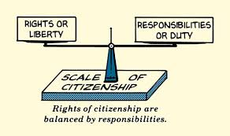
Duties and Rights
If a patient has a right within health care or to health care, for the most part, the health care professional has the duty to grant that right.
To fulfill one’s duty to honour patients’ rights, the health care professional must either act to carry out a responsibility or refrain from acting or interfering in a situation. (Example: honouring a ‘Do not resuscitate’ order.)

Slide 22

Autonomy and the Patient
The principle of autonomy serves as the basis for the principles involved in informed consent and self-determination regarding treatment choices.
Attitudes toward patient autonomy have changed over the years – health care has shifted from being physician-directed (paternalistic) to patient-centred.
This attitude change has resulted in revised versions of the Hippocratic Oath (e.g., Box 9.1, p. 255, in the textbook).

Slide 23

Truthfulness
All patients have a right to the truth, and health care providers have a duty to provide it.
The modern, patient-focused approach to treatment requires physicians to keep the patient fully and truthfully informed. (Examples include informing of terminal illness or other conditions that may upset patient.)

Slide 24

Parental Rights, Ethics, and the Law
When a patient is considered an adult, self-determination takes precedence over paternalistic intervention, even when the patient’s life is at stake.
When children are involved and parents reject medical intervention, the provincial or territorial courts almost always obtain legal custody for the child and allow the recommended treatment.

Slide 25
Inclusion, diversity, equity, and accessibility
Systemic anti-black racism
Anti-indigenous racism
Harmful colonial structures
Leading to approaches (IDEA)
Inclusion
Diversity
Equity
Accessibility
Inclusion. Creating environments in which any individual or group can be and feel welcomed, respected, represented, supported, and valued to fully participate.
Diversity. Examining the makeup of an institution to ensure that people from different backgrounds and with multiple perspectives are represented.
Equity. The fair and just treatment of all members of a community.
Accessibility. The commitment for everyone along the continuum of human ability and experience to be included in all programs and activities.
Mullin AE, Coe IR, Gooden EA, Tunde-Byass M, Wiley RE. Inclusion, diversity, equity, and accessibility: From organizational responsibility to leadership competency. Healthcare Management Forum. 2021;34(6):311-315. doi:10.1177/08404704211038232

Slide 26
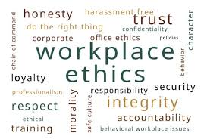
Ethics at Work
All regulated health care professions have codes of ethics, as do many places of employment.
A formal statement of an organization’s or profession’s values regarding professional behaviour, a code of ethics provides guidance for
Ethical decision making
Self-evaluation
Best practices policies
Professional conduct

Slide 27
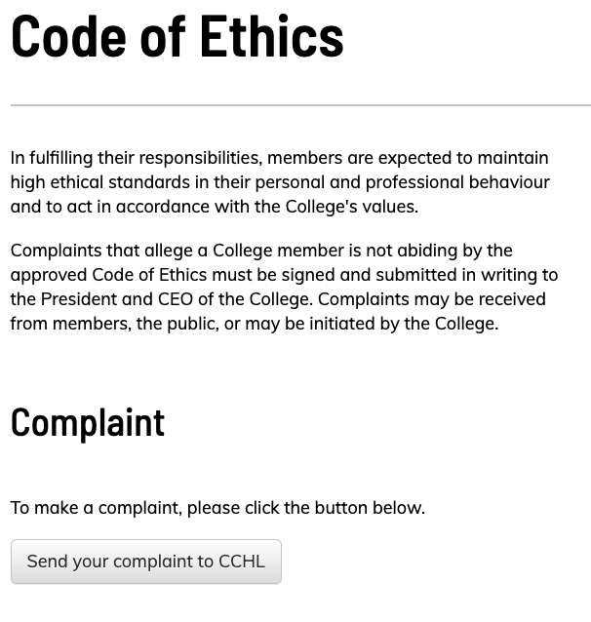

Canadian College of Health Leaders Code of Ethics

Slide 28
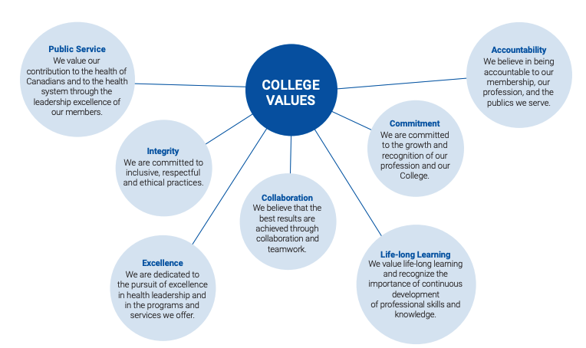
CCHL Values
https://cchl-ccls.ca/document/536/CCHL_CodeEthics_EN.pdf

Slide 29
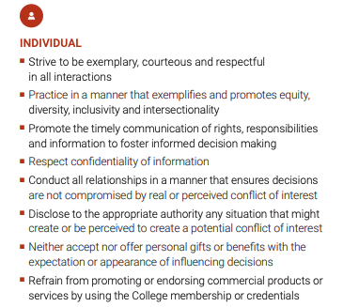
CCHL Code of Ethics

Slide 30
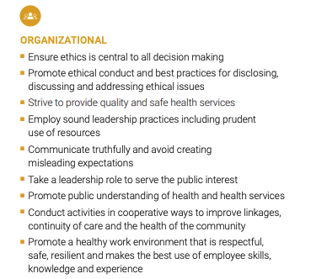
CCHL Code of Ethics

Slide 31
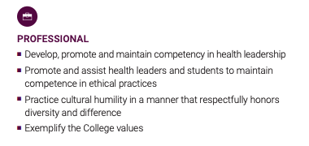
CCHL Code of Ethics

Slide 32
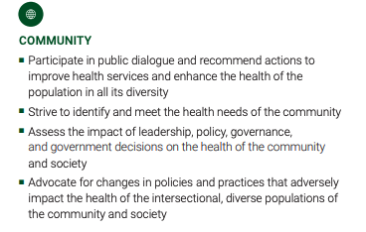
CCHL Code of Ethics

Slide 33
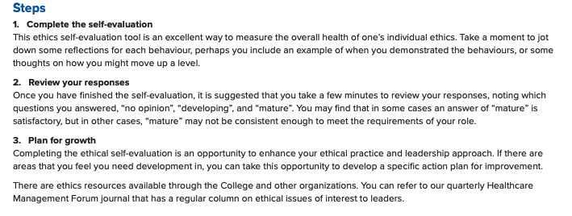
CCHL: Ethics Self-Evaluation Tool
https://cchl-ccls.ca/document/3023/CCHL_Code_of_Ethics_Self_Evaluation_Tool_ENG.pdf

Slide 34
International Medical Informatics Association Code of Ethics
Fundamental Ethical Principles
1. Principle of Autonomy
All persons have a fundamental right to self-determination.
2. Principle of Equality and Justice
All persons are equal as persons and have a right to be treated accordingly.
3. Principle of Beneficence
All persons have a duty to advance the good of others where the nature of this good is in keeping with the fundamental and ethically defensible values of the affected party.
4. Principle of Non-Malfeasance
All persons have a duty to prevent harm to other persons insofar as it lies within their power to do so without undue harm to themselves.
5. Principle of Impossibility
All rights and duties hold subject to the condition that it is possible to meet them under the circumstances that obtain.
6. Principle of Integrity
Whoever has an obligation has a duty to fulfil that obligation to the best of their ability
https://imia-medinfo.org/wp/wp-content/uploads/2015/07/IMIA-Code-of-Ethics-2016.pdf

Slide 35
General principles of informatic ethics
1. Principle of Information-Privacy and Disposition
All persons and group of persons have a fundamental right to privacy, and hence to control over the collection, storage, access, use, communication, manipulation, linkage and disposition of data about themselves.
2. Principle of Openness
The collection, storage, access, use, communication, manipulation, linkage and disposition of personal data must be disclosed in an appropriate and timely fashion to the subject or subjects of those data.
3. Principle of Security
Data that have been legitimately collected about persons or groups of persons should be protected by all reasonable and appropriate measures against loss degradation, unauthorized destruction, access, use, manipulation, linkage, modification or communication.
4. Principle of Access
The subjects of electronic health records have the right of access to those records and the right to correct them with respect to its accurateness, completeness and relevance.
5. Principle of Legitimate Infringement
The fundamental right of privacy and of control over the collection, storage, access, use, manipulation, linkage, communication and disposition of personal data is conditioned only by the legitimate, appropriate and relevant data-needs of a free, responsible and democratic society, and by the equal and competing rights of others.
6. Principle of the Least Intrusive Alternative
Any infringement of the privacy rights of a person or group of persons, and of their right of control over data about them, may only occur in the least intrusive fashion and with a minimum of interference with the rights of the affected parties.
7. Principle of Accountability
Any infringement of the privacy rights of a person or group of persons, and of the right to control over data about them, must be justified to the latter in good time and in an appropriate fashion.

Slide 36

The Ethics Committee
An ethics committee consists of a group of people who
Listen to, evaluate, and make recommendations about acts perceived as unethical
Provide health care providers with guidance in making controversial medical decisions
Compile research for policy development within the facility

Slide 37

Human research ethics
The Human Research Ethics Board (HREB) ensures that UVic research and research occurring in academic courses involving human participants or human biological materials meets the ethical standards required by Canadian universities and national regulatory bodies.
The research ethics staff can provide research ethics advice, education, and up-to-date regulatory information. We make presentations to classes and offer individual and project-specific guidance to you and your students.
https://www.uvic.ca/research-services/home/regapproval/humanethics/index.php

Slide 38
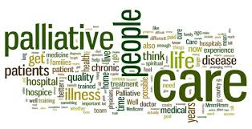
End-of-Life Issues
End-of-life issues that raise ethical concerns include
Establishing do not resuscitate (DNR) protocols
Patients who wish to withdraw life-saving measures
Requesting supportive or palliative care
Requesting medical assistance in dying

Slide 39

Euthanasia
Various categories of euthanasia exist:
Voluntary euthanasia
Involuntary euthanasia
Active euthanasia
Passive euthanasia
Medical assistance in dying (MAID)
With the exception of passive euthanasia, and medical assistance in dying where legal, the act of ending or assisting to end a person’s life is illegal in most countries

Slide 40
Preparation for End-of-Life Decisions
A person entering a health care facility can request a do not resuscitate order (DNR)
Health care providers are legally bound to honour such requests.
A person can reverse his or her DNR request at any time.
Advanced directives specify the nature and level of treatment a person would want to receive in the event that he or she becomes unable to make those decisions at a later time.

Slide 41
Preparation for End-of-Life Decisions
Levels of care reflects a choice of end-of-life interventions usually assigned to nursing in long-term care facilities.
Level 1 –The resident wishes to stay in their home
Level 2 – The resident wants to stay in the facility and receive all treatments, medications, and interventions that are possible at that facility
Level 3 – The resident would be transferred to an acute care facility and receive treatment excluding CPR protocol, or transfer to the intensive care unit
Level 4 – The resident would be transferred to an acute care facility for all active measures required to sustain life

Slide 42

Palliative Care
Palliative care addresses the physical and emotional needs of those who are dying.
Teams of experts work with patients and their families to manage physical discomfort and psychological distress and to meet spiritual needs.

Slide 43

Allocation of Resources
The term allocation of resources refers to who gets what, when, and for what reason.
Rising health care costs, expensive technologies, and limited access to many services have made the allocation of resources an increasing concern in the health care industry.
Resource allocation issues include organ transplantation and finances and resources

Slide 44
Abortion
Abortion has been legal without restrictions in Canada since 1984.
Health care providers are not obliged to perform abortions, and can refuse to perform them because of religious or moral beliefs.
Individuals can self-refer to abortion clinics.
Access to and coverage for abortion varies among the provinces and territories.
The moral and ethical issues around abortion concern two main issues:
The right of the fetus to life
The right of women to make decisions that involve their own bodies

Slide 45

Genetic Testing
Through genetic testing people can learn whether they carry any genes that put them at a higher risk for disease, such as certain types of cancer, Alzheimer disease, and Huntington disease.
Similarly, carrier testing determines whether the potential exists to pass on a genetic disease to offspring.

Slide 46

Genetic Testing
Prenatal diagnostic screening can
Determine a fetus’s risk for certain genetic disorders
Aid in earlier diagnosis of fetal abnormalities
Provide prospective parents with important information for making informed decisions about a pregnancy
Canadians are encouraged to think carefully before having genetic testing for presumed or established conditions.

Slide 47



